Slide 1
Adversarial Domain Adaptation with K-dimensional Discriminator head
Prasanna B
MLSP Final Project 2022

Slide 2
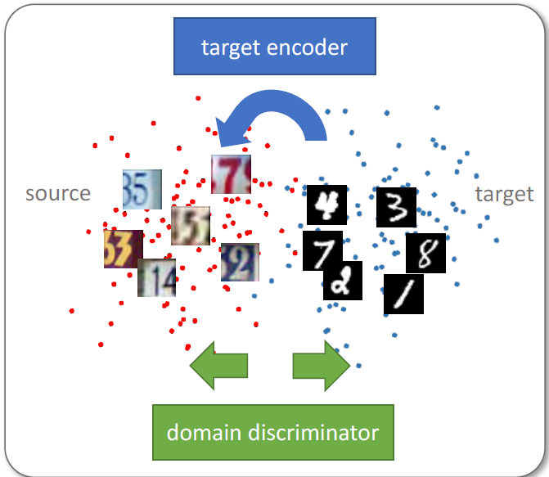
Problem Definition
Given:
A neural network model trained on a source domain
Unlabeled target domain data consisting of same labels as source domain
Aim:
Adapt the given model to the target domain data
Dataset:
Source – MNIST
28x28 grayscale digit images
60,000 train samples
10,000 test samples
Target – USPS
28x28 grayscale digit images (originally 16x16 but 28x28 up-sampled dataset used)
7291 train samples
2007 test samples
Image taken from [1]

Slide 3
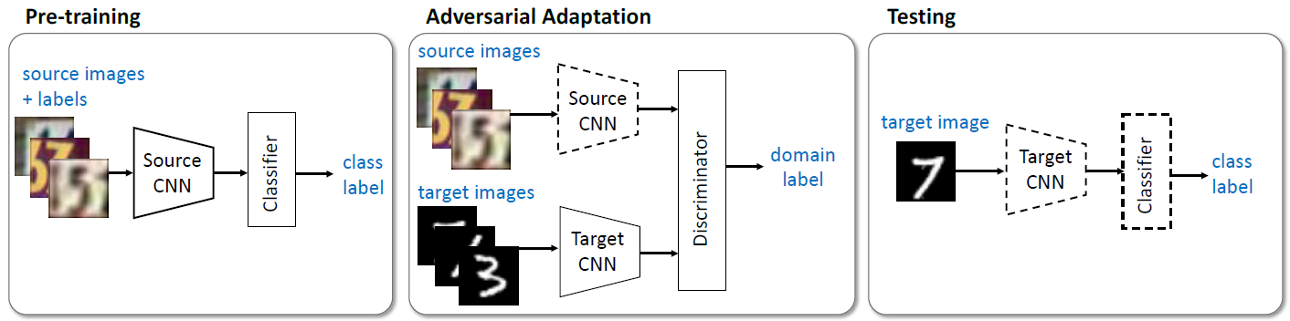
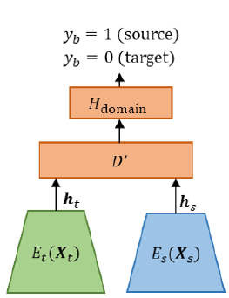
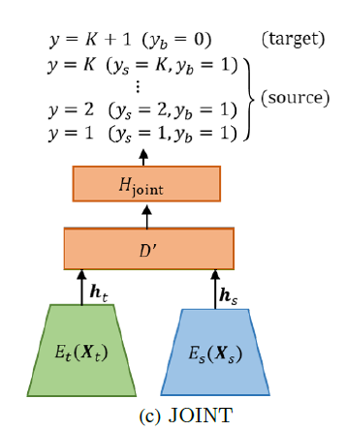
Technical Details
Original ADDA Architecture
Architecture Modification (inspired from [2])
Images taken from [1] and [2]

Slide 4


Results
Accuracies on Target Dataset (USPS) after adaptation
On Original ADDA Architecture (2-head discriminator)
On Modified Architecture(11-head discriminator)

Slide 5


Novel Contributions
Adopted the idea (from [2]) of taking advantage of source data labels while training the discriminator which performed better than ADDA
Existing repositories for ADDA were implemented using PyTorch 0.2.0, hence lots of code need to be modified and updated. Found and debugged all of them to work in PyTorch 1.10.0
Parameters for transformation of Images and normalization of USPS during preprocessing used in repository code resulted in very poor Adaptation. Fixed these to get good performance.
References:
Adversarial Discriminative Domain Adaptation by Tzeng et al., 2017 - https://arxiv.org/abs/1702.05464
Improved Techniques for Adversarial Discriminative Domain Adaptation - https://arxiv.org/abs/1809.03625
https://github.com/corenel/pytorch-adda

